Slide 1
Getting Started with Java
Notes:
This chapter gives a quick introduction to the Java tools we're going to be using on the course. We also show how to create and run a simple Java application.

Slide 2
Contents
Setting the scene
Installing and using Java SE
Using an IDE
Demo folder: DemoGettingStarted
Notes:
In this chapter we'll take our first look at Java syntax, and see how to build and run Java applications both from the command line and using the Eclipse Integrated Development Environment (IDE).

Slide 3
1. Setting the Scene
Hello Java
The origins of Java
What are the JDK and JRE?
The Java product family
What can you do with Java SE?
What can you do with Java EE?
Notes:
We'll kick off this chapter with an overview of the Java platform. We'll describe the difference between the JDK and the JRE, and we'll also summarize the features available in Java SE and Java EE.

Slide 4
Hello Java
Java is one of the most widely-used object-oriented languages in contemporary software development
Other popular OO languages include C#, C++, etc.
OO principles:
Classes and objects
Inheritance
Polymorphism
Notes:
Java emerged in the mid 1990's and has grown in scope, popularity, and complexity over the last two decades. Java is fully object oriented:
You define classes to represent abstractions of the real world. For example, you can define classes such as Person, BankAccount, Transaction, Payment, and so on. A class specifies data plus a related set of operations. For example, a BankAccount class might define data members such as balance and accountHolder, and operations such as deposit() and withdraw().
You use encapsulation to keep details as private as possible within your classes. For example, you define the data values private inside a class, so that other parts of the application can't access the data directly. This helps you create more robust code, which you can modify more safely without worrying about breaking other parts of the application.
You can use inheritance to define a new class based on an existing class. This enables you to reuse existing classes, so that you can define a new class more quickly in terms of how it differs from an existing class. We call the existing class the "superclass", and the new (variant) class the "subclass".
Polymorphism is related to inheritance. It's a mechanism that allows you to create objects for different subclasses (e.g. different kinds of bank accounts), where each subclass implements certain operations differently (e.g. different rules for withdrawing money). Via polymorphism, you can use all these objects in a consistent manner, without knowing what type of object it is.

Slide 5
The Origins of Java
Sun Microsystems introduced Java in 1996
The original aim of Java was to create platform-agnostic apps for mobile devices
That's where the idea of the JVM came from!
Java 1.0 included:
A Java Development Kit (JDK)
A Java Runtime Environment (JRE)
See the following slides for a description of JDK and JRE
Notes:
When Java first emerged, it had a very small set of standard classes. There were just 6 packages (a package is a group of related classes, e.g. the java.io package contains classes that perform file I/O).
Since its first appearance, Java has grown into a massively popular language for creating all kinds of application. For example:
Android applications for mobile devices are written in Java.
Server-side applications for generating web pages and for implementing web services can be written in Java (or C#, or PHP, etc.)
Utility applications for file handling, command-line tools etc. can be implemented in Java (or Perl, or PowerShell, etc.)
Oracle are the current owners of the Java specifications. This course describes features in Java Standard Edition (SE) version 8.

Slide 6
What are the JDK and JRE?
The JDK contains everything you need to create and run Java applications
Standard Java classes
javac
java
jdb
jar
The JRE is a subset of the JDK - it just contains the tools you need to run (but not create) Java applications
Standard Java classes
java
Notes:
The JDK contains tools and core libraries that allow you to develop and run Java applications, including:
Standard Java classes Java contains thousands of standard classes to help you write your applications, e.g. String, File, Connection, Jwindow, etc.
javac This program is the Java compiler. You use javac to compile Java source code into Java byte codes, i.e. to compile .java files into .class files.
java This program is the Java Virtual Machine (JVM). The JVM provides the protected run-time environment on which all Java applications run.
jdb This program is the command-line debugger. You can use jdb to detect and diagnose bugs in your code. In practice, a much better approach is to use the debugging facilities provided by an Integrated Development Environment (IDE) such as Eclipse, IntelliJ, NetBeans, etc.
jar This program creates Java Archive (JAR) files. A JAR file is a zip file that contains a library of Java code.
The JRE just contains a subset of the JDK. The JRE doesn't contain any development-related tools - it just contains the bare minimum to allow you to run existing Java applications.

Slide 7
The Java Product Family
Sun reorganized their Java products in 1999
Java 2 Standard Edition (J2SE)
Java 2 Enterprise Edition (J2EE)
Java 2 Micro Edition (J2ME)
There have been many subsequent upgrades to the language and libraries
We're covering Java SE 8 on this course, for the purposes of the Oracle Certified Java Associate exam
Also note:
Java is now owned by Oracle, not Sun ☺
Notes:
This course covers Java Standard Edition (SE) version 8, the most recent version currently available. Oracle are planning to launch Java 9 in September 2017, but the deadline has slipped several times already so don't hold your breath!

Slide 8
What can you do with Java SE?
You can use Java SE to:
Create standalone Java applications
Create Windows-based applications (Swing)
Manipulate text files, binary files, and XML data
Access databases, via Java Database Connectivity (JDBC)
Create multithreaded applications
Create client-server applications, using Remote Method Invocation (RMI)
Notes:
This slide summarizes the main capabilities of the Java SE platform. The Java SE class library contains a large number of classes that allow you to perform these tasks, plus much more beside.
The library is large and sometimes rather complex. As your Java programming career develops, you'll find yourself gaining more experience in the relevant nooks and crannies that are relevant to your needs. Don't feel obliged to sit down with a large API book and try to learn the libraries by rote!

Slide 9
What can you do with Java EE?
Going further, you can use Java EE to create:
Web applications, using servlets and JavaServer Pages (JSPs)
Web services
Web sockets
Middle-tier session beans, using Enterprise JavaBeans (EJBs)
Data-access entity beans, using the Java Persistence API (JPA)
Message-queuing apps, using the Java Message Service (JMS)
Notes:
Java EE is a layer on top of Java SE. Java EE provides a large number of additional classes (plus several additional command-line tools) that enable you to create enterprise applications, including:
Web applications, using a variety of APIs.
Web services, both SOAP-based and REST-based.
Web sockets, which allow you to create client-server applications that can communicate in both directions simultaneously over the Internet.
EJB components, which benefit from pooling, declarative security, transaction management, etc.
Object persistence, via the JPA API.
Message-based systems, by sending/receiving messages to a queue or by publishing/subscribing to messages in topics.
Note: Java EE is outside the scope of this course. We cover Java EE in detail in our Practical Java EE course.

Slide 10
2. Installing and Using Java SE
Overview
Downloading Java SE
Installing Java SE
Java SE folder structure
Writing a simple Java application
Compiling the Java application
Running the Java application
Notes:
This section describes how to download and install the Java SE. We also show how to write a simple "Hello World" Java application, compile it, and then run it from the command line.

Slide 11
Overview
You can download everything you need to develop Java applications free of charge
The setup for this course uses two products:
The Java SE 8 JDK
The Eclipse integrated development environment (IDE)
We'll describe how to download and install these products, in case you want to set up your own machine at home ☺
This section discusses the Java SE 8 JDK
The next section discusses Eclipse
Notes:
One of the nice things about developing in Java is that you can get most of what you need for free.
It's actually quite informative for you to learn how to set up Java for yourself, because you'll doubtless need to do this many times in your Java career. So that's what we're going to do - we'll discuss how to install Java SE in this section, and then see how to install Eclipse in the next section.

Slide 12
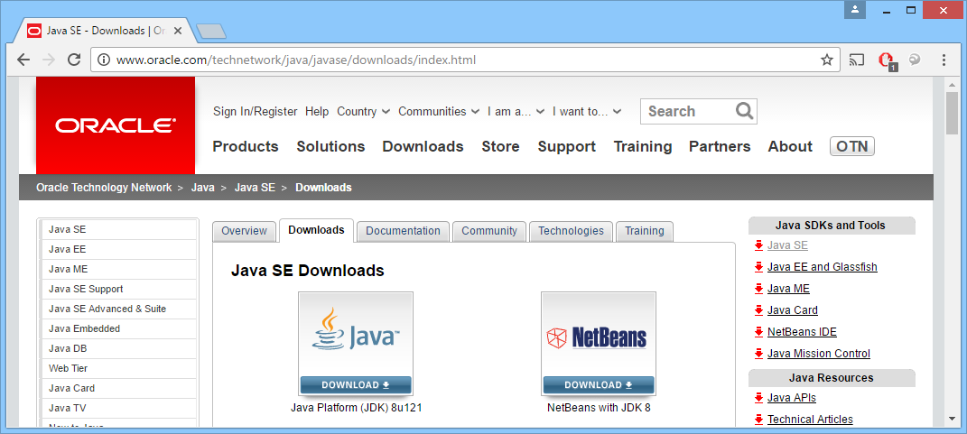
Downloading Java SE
Download Java SE (details vary depending on version) :
http://www.oracle.com/technetwork /java/javase/downloads/index.html
Download the JDK
(Java Development Kit)
Notes:
Oracle are the current owners and custodians of Java standards and products. Almost everything Java-related is free.
The computers on this course already have Java SE and Eclipse installed, but it's worthwhile describing how to set everything up from scratch anyway, because you'll have to do it yourself at some point.
You can download Java SE from the following web site:
http://www.oracle.com/technetwork/java/javase/downloads/index.html
The screenshot in the slide above shows this web site (your screenshot might differ, depending on version numbers etc.). Click the link to download the Java Platform (JDK). We're using the JDK version 8 for the installation on this course.
Note: The download page differentiates between the JDK and JRE:
The JDK is the Java Development Kit, and includes command-line tools such as the Java compiler, Java debugger, JAR tool, etc. If you want to develop Java applications (as well as run them, obviously), this is what you need.
The JRE is the Java Runtime Environment, and includes the minimal set of tools you need to run Java applications. It's a subset of the JDK. If you just want to run Java applications (i.e. not develop them), this is all you need.

Slide 13
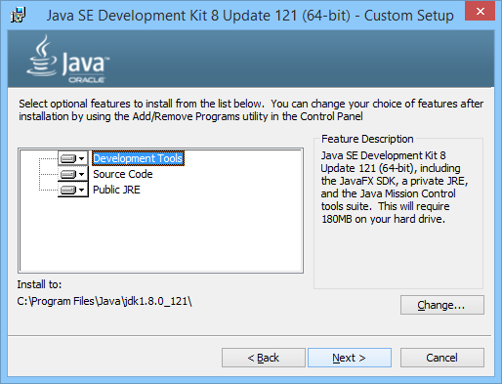
Installing Java SE
Select and run the appropriate JDK installation
E.g. jdk-8u121-windows-x64.exe
Accept all defaults during installation
Notes:
Make sure you select the correct JDK installation for your target computer, e.g. Linux, Solaris, Windows 32-bit or 64-bit.
When the JDK download is complete, just run it and accept all the default options during installation.

Slide 14

Java SE Folder Structure
Default installation folder for Java SE (v1.8, update xx):
C:\Program Files\Java\jdk1.8.0_xx
Folder structure:
Notes:
The screenshot in the slide above shows the installation folder for the JDK. Here's a brief description of each sub-folder:
bin Contains the JDK tools (compiler, etc.)
db Contains a Java-based database engine called Derby.
include Contains C/C++ header files if you want to integrate your Java code with native C/C++ code via JNI (Java Native Interface). JNI is out of the scope of this course.
jre Contains JRE tools (JVM, etc.)
lib Contains various library used by the JDK tools.

Slide 15
Writing a Simple Java Application
You can use any editor to create a Java application
E.g. Notepad, Notepad++, vi, etc.
Here's a simple "hello world" Java class
Java is object-oriented, so all code must go inside a class
Java applications must have a special function named main(), which is the starting point for the application
Note:
The file name must be classname.java
public class MyFirstApp {
public static void main(String[] args) {
System.out.println("Hello world");
}
}
MyFirstApp.java
Notes:
This slide shows a traditional "Hello World" application, as implemented in Java. The code box shows MyFirstApp.java – you can find this file on your computer, in the demos folder for this chapter.
We won't worry too much about the syntax yet – it should look reasonably intuitive. We'll just point out three main points at this stage:
MyFirstApp.java defines a public class named MyFirstApp. Everything in Java must reside inside a class, because Java is completely OO. You can't define anything outside of a class (unlike in C or C++, where you can define global variables and functions).
A Java file can only contain a single public Java class, and the class name must correspond to the file name.
The class has a main() method, which is the entry point for this application. The main() function simply displays a message on the console, via the System.out.println() function.

Slide 16
Compiling the Java Application
You can compile the class from the command line
Using the Java compiler, javac.exe
Note, javac.exe must be on the path
Also, the classes that you use must be on the "classpath"
Assuming there are no compiler errors(!), the compiler creates MyFirstApp.class
Contains the Java byte-codes for your class
C:\> javac MyFirstApp.java
Notes:
Before you can run a Java class, you must first compile it via javac (i.e. the Java compiler). You can run this from the command line – but be sure javac is on the system path.
The Java compiler compiles MyFirstApp.java into a binary file named MyFirstApp.class. The binary file contains Java byte codes, i.e. compiled Java instructions.
You cannot run MyFirstApp.class directly on your operating system – you must run it through the JVM instead, as described on the next slide.

Slide 17
Running the Java Application
Run the class from the command line
Via the JVM, java.exe
Note, java.exe must be on the path
Also, the classes that you use must be on the "classpath"
Note:
Specify the class name without the .class file extension
C:\> java MyFirstApp
Hello world
Notes:
To run a Java application, you must always run it through the JVM. To do this, run the java application and specify the name of your class file (without the .class file extension).
The java application is the JVM. The JVM loads your class definition into memory, and JIT-compiles the Java byte codes into native machine instructions for your particular target computer.
There are ports of the JVM to a wide range of operating systems and platforms. This means you can run the same Java code on many platforms without recompilation – all you need is an appropriate JVM for your particular platform.

Slide 18
3. Using an IDE
Popular Java IDEs
Downloading and installing Eclipse
Starting Eclipse
Creating a project
Adding a class
Implementing the class
Running the class
Debugging code
Notes:
Now that you know how to run the basic JDK tools from the command line, we're going to shift gear and show how to use an IDE.
In practice, all Java developers use an IDE (rather than a text editor and the command line). Using an IDE offers the following benefits:
Improves productivity
Simplifies compile/run cycle
Offers IntelliSense
Provides code refactoring capabilities
Simplifies library management

Slide 19
Popular Java IDEs
Popular Java IDEs:
Eclipse (we'll be using this)
IDEA IntelliJ
Oracle JDeveloper
IBM WebSphere Application Developer
NetBeans
Etc…
Notes:
We're going to use Eclipse for Java SE on this course. It's free and extremely extensible via plug-ins.
Other IDEs are available. The slide lists some popular choices. Not all these IDEs are free, although this won't be an issue for you if your company has purchased a site license for the product.

Slide 20
Downloading and Installing Eclipse
To download Eclipse:
Browse to https://www.eclipse.org/downloads/ and click the DOWNLOAD 64 BIT button. In the next screen, click the DOWNLOAD button.
After the Eclipse Installer has completely downloaded, run it.
In the Eclipse Installer dialog box, click Eclipse IDE for Java Developers.
In the next dialog box, specify an installation folder of your choice, and then click INSTALL. Accept all default options, and launch Eclipse when instructed.
Notes:
Note: This slide describes how to download and install Eclipse. This is for background information only – we've already installed Eclipse on your computer for this course.
Eclipse offers several different IDEs, aimed at different programming languages and development targets.
We'll be using Eclipse IDE for Java Developers, which basically means it targets Java SE. Note that there's also an Eclipse for Java EE, which includes additional wizards and libraries for building enterprise applications.
Make sure you download the appropriate file for your platform, e.g. Linux, Windows 32-bit, or Windows 64-bit.

Slide 21
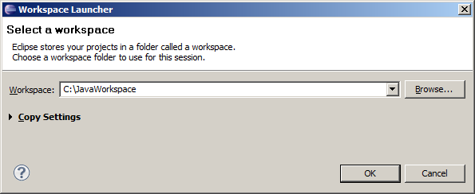
Starting Eclipse
Start Eclipse
i.e. run c:\<ECLIPSE-HOME>\eclipse.exe
Eclipse prompts you for a workspace
The workspace is a folder that will contain all your Java projects
Specify C:\JavaWorkspace
Eclipse will create this folder, and will store your Java projects here
Notes:
When you run the Eclipse IDE, you will be asked to select a workspace. A workspace is a folder where you will put your Eclipse Java projects. You should enter a workspace name such as C:\JavaWorkspace.
When Eclipse has started, you can modify the configuration settings so that it is compliant with a particular version of the Java JDK. This is very useful if you have existing Java code that was written under a previous version of Java. To do this, invoke the Window | Preferences menu option, then perform these steps in the Preferences dialog box:
Expand Java, and then click Compiler
Set the Compiler compliance level (e.g. to 1.8)
Click OK

Slide 22
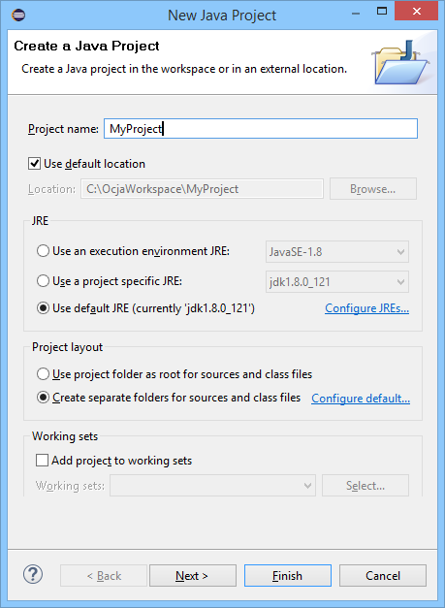
Creating a Project
Create a new Java project
Via File | New | Java Project
Specify a meaningful project name, e.g. MyProject
Accept default options
Note:
You might need to change the JRE option…
Depending on what versions of the JRE you want to use
Notes:
You can create a new Java project in the workspace as follows:
On the File menu, click New, then click Java Project.
In the New Java Project dialog box, enter a meaningful project name such as MyFirstProject. You can accept all the other default options, e.g. the JRE execution environment should point to your Java 8 JRE. Click Finish to close the dialog box.
After you close the New Java Project dialog box, your project should now appear in the Package Explorer pane.

Slide 23
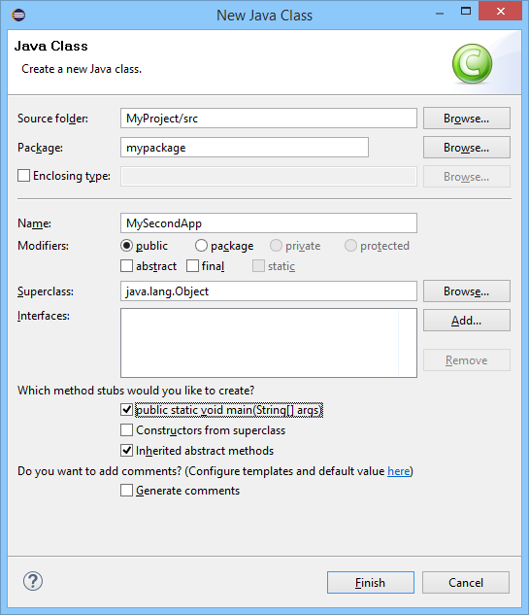
Adding a Class
In the src folder, add a class
Preferably in a named package
(A package is a group of related classes)
Notes:
You can create a new Java class in your project as follows:
Right-click the src folder. In the popup menu, click New, and then click Class.
In the New Java Class dialog box, enter a meaningful name for the class (e.g. MyClass). Class names always start with an uppercase letter in Java.
Enter a meaningful name for the package (e.g. mypackage). You should always put your Java classes into a package. Package names are always lowercase in Java. We'll discuss packages in more detail later in the course.
Notice there's a checkbox that enables you to auto-generate a main method for your class. Select this option, to save yourself some typing!
After you close the New Java Class dialog box, the class should appear in the code editor pane in the IDE.

Slide 24
Implementing the Class
Implement the class, e.g:
You don't need to compile the file explicitly
Eclipse automatically compiles your code when you save the file!
Any syntax errors will be highlighted with squiggles
package mypackage;
public class MySecondApp {
public static void main(String[] args) {
System.out.println("Eclipse says Hello!");
}
}
MySecondApp.java
Notes:
This slide shows a simple implementation for MyClass. The main point at this stage is just to get something working!

Slide 25
Running the Class
To run the class using Eclipse:
Right-click in Code Editor window, and click Run As | Java Application
(Eclipse has access to JDK and classpath)
Displays output in Console window
Notes:
To run the class using Eclipse:
Right-click in code editor pane, click Run As, and then click Application. Note that Eclipse has access to the JDK and classpath, so it's quite capable of compiling and running Java applications.
The application runs and displays its output in console window.

Slide 26
Debugging Code
All IDEs include comprehensive debugger support, which allows you to:
Set breakpoints
Single-step through code
Watch local variables and other expressions
View the call stack
Examine threads
Etc!
To debug a class using Eclipse:
Right-click in Code Editor window, and click Debug As | Java Application
Notes:
Eclipse also lets you debug a class. Set breakpoints anywhere in the code by double-clicking in the left-hand-side margin next to the code, and then run the class in debug mode via the Debug As | Application menu option.

Slide 27
Any Questions?

